Slide 1
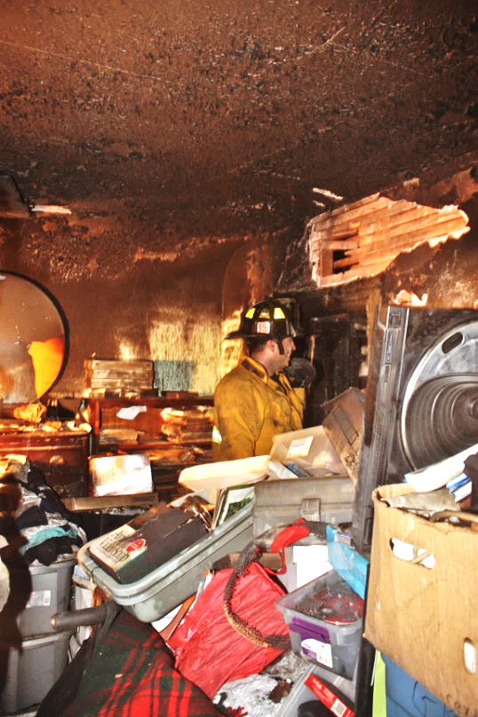
HOARDING is a Health and Safety Issue
Presentation
Michael Alexander

Slide 3
Defining Hoarding
Dictionary: a supply or accumulation that is hidden or carefully guarded for preservation, future use, etc.
Mayo Clinic: the excessive collection of items, along with the inability to discard things
The International OCD (Obsessive-Compulsive Disorder) Foundation: Three connected problems:
Collecting too many items
Difficulty getting rid of items, and
Problems with organization

Slide 4
History of Hoarding
Dante’s Divine Comedy: 1308-1321
Charles Dickens’ Bleak House: 1862
Sir Arthur Conan Doyle’s Sherlock Holmes: 1887
1980: one of nine diagnostic criteria for OCD in the Diagnostic and Statistical Manual of Mental Disorders published by the American Psychiatric Association
1993: First systematic study and definition published by Frost and Gross

Slide 5
Who hoards?
Equal Opportunity Affliction
Wealthy, middle income, poor, homeless
Elderly, middle age, young adults, children
People who have lived through a depression or in war ravaged countries, as well as those from affluent families who have never experienced poverty or trauma
Research has found that most adults with hoarding issues had some hoarding habits by the age of 13 and even younger

Slide 6
Why do people hoard?
According to Dr. David Tolin, Director of the Anxiety Disorders Center at the Institute of Living at Hartford Hospital:
Because of perfectionism
Fear of throwing something away that is useful
Emotional attachment
Starts in early adolescence or younger
Family history
Stressful life

Slide 7
History of alcohol abuse
Social isolation
Scarcity
Learned behavior
Familiar Quote: “Waste not, want not” 1772
And remember family conversations around the dinner table…

Slide 8
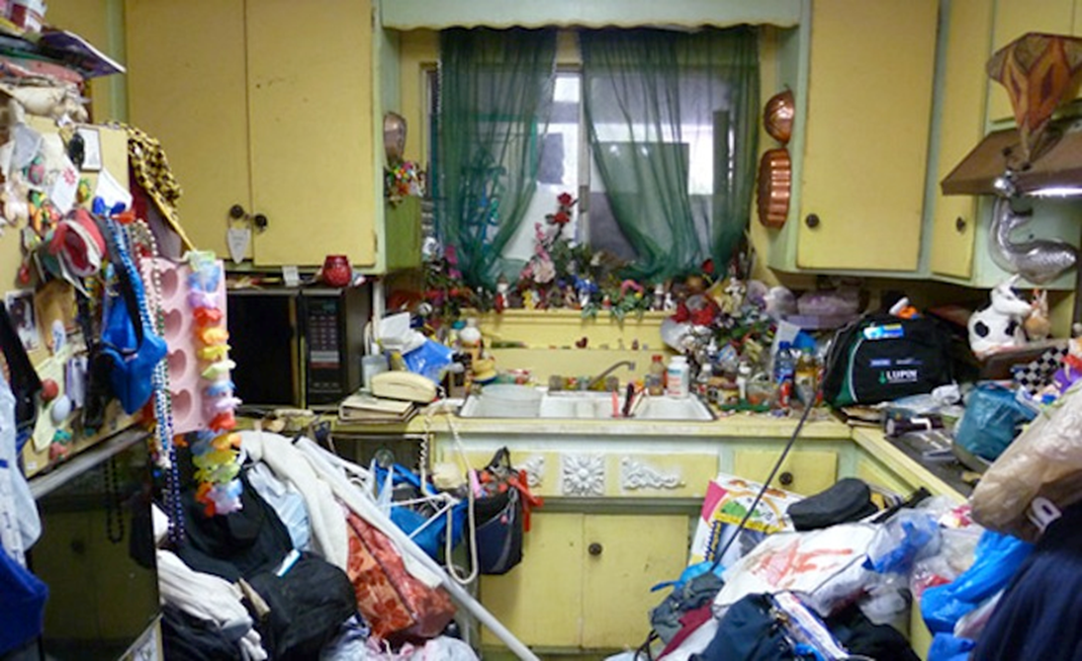
Signs of Hoarding
Too much shopping
Collecting free things
Areas and surfaces stacked with “stuff”

Slide 9
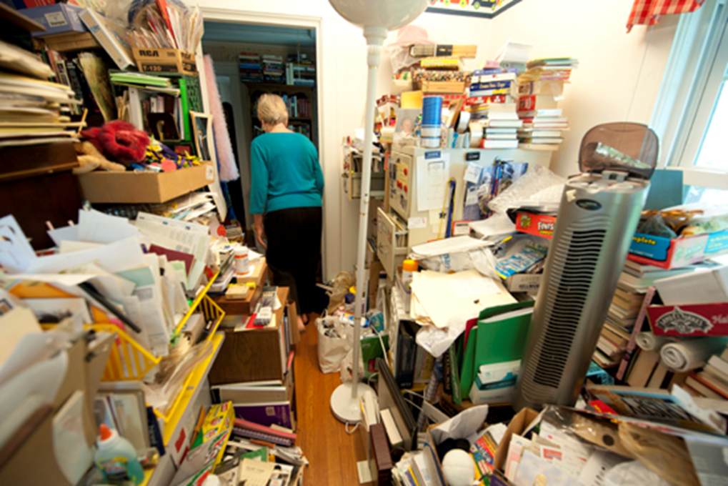
Cluttered living spaces
Inability to discard items
Keeping stacks of newspapers, magazines, junk mail
Craft projects never completed

Slide 10
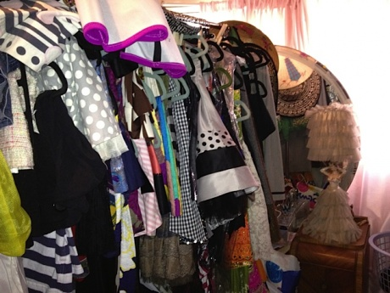
Gifts for others that are never given away
Clothes that don’t fit
Broken things to be fixed some day
Items moved from one pile to another

Slide 11
Acquiring unneeded or seemingly useless items
Difficulty managing daily activities
Difficulty organizing items
Shame or embarrassment
Excessive attachment to possessions, including discomfort with letting others touch or borrow possessions
Limited or anti-social interactions
Hoarders are different from collectors…

Slide 12
Risks and Complications
Unsanitary conditions that pose a risk to health including infestation
Increased risk of falls
Inability to perform daily tasks, such as bathing or cooking
Refusal to allow repair or maintenance people for fear of them seeing the clutter
Poor work performance
Family conflicts
Loneliness and social isolation
Depression or anxious much of the time because of the clutter
Fire hazards

Slide 13
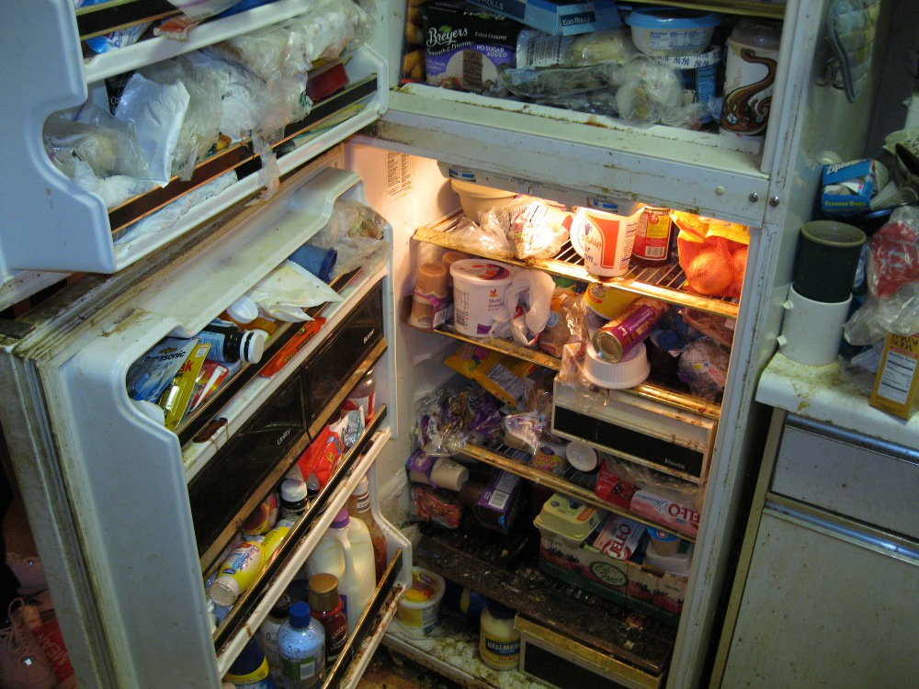
Even Refrigerators!

Slide 14
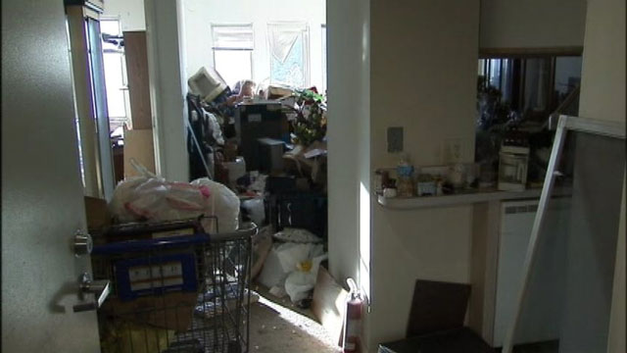
Egress!

Slide 15
Communicating with Hoarders
Don’t
Use Judgmental Language
Use words that devalue or negatively judge possessions
Let your non-verbal expression say what you are thinking
Make suggestions about the person’s belongings
Try to persuade or argue with the person
Touch the person’s belongings without explicit permission

Slide 16
DO
Imagine yourself in the hoarding client’s shoes
Match the person’s language
Use encouraging language
Highlight strengths
Focus the intervention on safety and organization of possessions and later work on discarding

Slide 17
Who Hoards?

Slide 18
What if it doesn’t Work?
Family Intervention Plan
Health Care Worker/Providers
Adult Protective Services
Hoarding Task Forces
https://www.houstonhoarding.com
http://thehoardingproject.org/home/(Washington State has a “Hoarding” Project)

Slide 19
Hoarding and Legal Issues
Lease/House Rules
Protective Service Workers
Public Health or Fire Departments
Animal Workers
Legal Interventions
Eviction
Mandate Clean Out
Remove Vulnerable Individuals from the unit

Slide 20
Your Property
Do not confuse clutter with Hoarding
How is this addressed in your house rules?
Hoarding: A unit is considered to have a hoarding problem when there is excessive clutter in areas that will not allow emergency personnel to attend to residents in need of attention. Blocked egress areas must be addressed immediately and cleared to enable residents to leave the unit in case of emergency.

Slide 21
Unit Inspections: Units are inspected on a regular basis to make sure that all health and safety issues are addressed and corrected. If the unit fails the inspection, the unit will be re-inspected within ten days to note all corrections. If the unit fails inspection ___ times (as many as you want to enforce), eviction proceedings may begin.
Corrective Actions place in resident’s files
Court Tip
Remember:
Document, Document, Document

Slide 22
Resources
http://www.oprah.com/home/How-to-Stop-Hoarding-Resources
http://psychcentral.com/blog/archives/2011/03/19/compulsive-hoarding and-6-tips-to-help/
http://www.ehow.com/print/how_8006339_hoarder.html
http://www.mayoclinic.com/print/hoarding/DS00966/METHOD=print&DSECTION=all
http://www.harthosp.org/InstituteOfLiving/AnxietyDisordersCenter/CompulsiveHoarding/OnlineAssessment/default.aspx
http://www.ocfoundation.org/hoarding/print.aspx?id=703
http://www.ocfoundation.org/hoarding/task_forces.aspx
http://www.ocfoundation.org/hoarding/legal_issues.aspx
http://www.icarevillage.com/common-concerns-hoarding.aspx

Slide 23
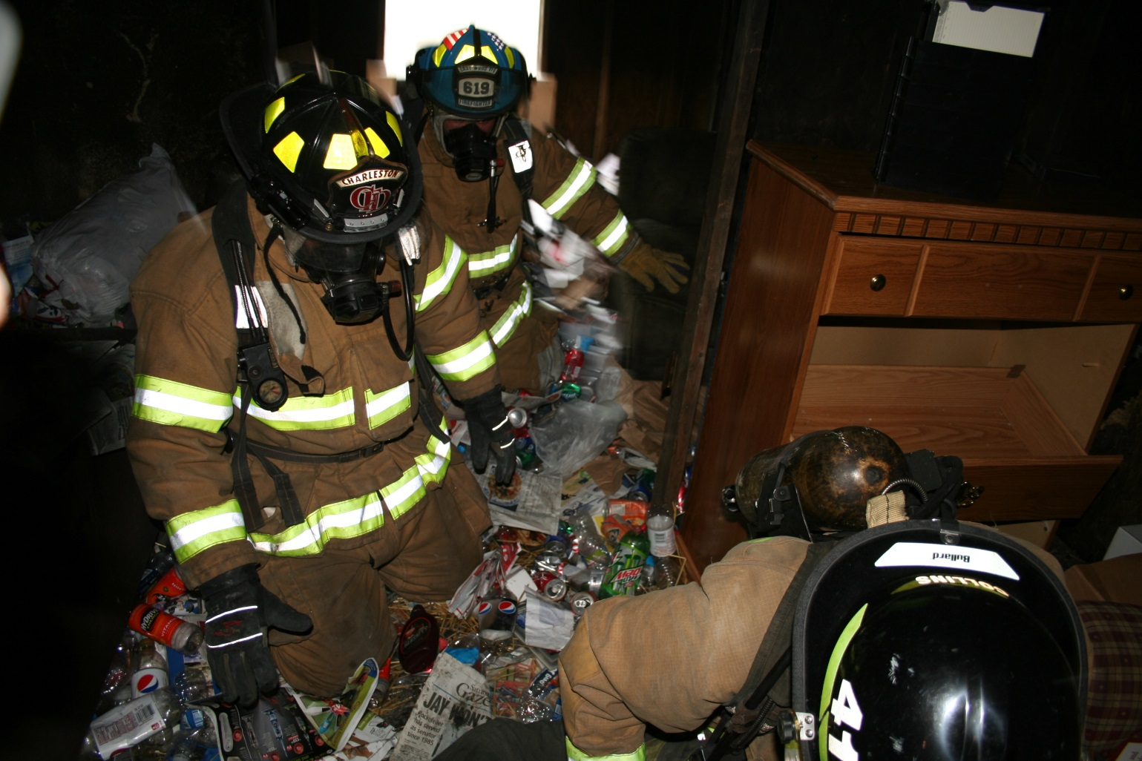
We don’t want to see this on our properties?

Slide 24
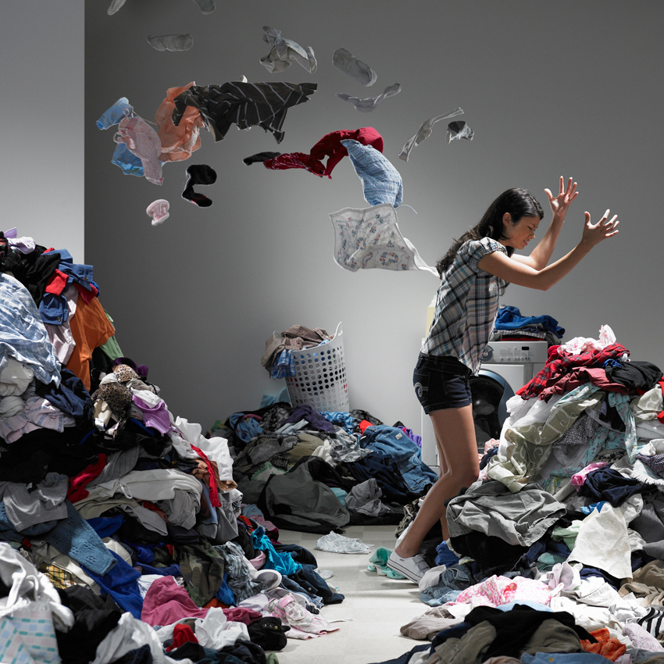
Where are my white shorts?

Slide 25
“Are you kidding, I am just getting ready for winter!”

