Slide 1
Presented by Eric Siebens
Section 515 Bootcamp

Slide 2
Summer Meals Program Multi-Family Properties partnering with USDA FNS and local non-profits to provide summer meals to children in Rural Communities. Washington State RD Contact Ed Reynolds 360-704-7765 benjamin.reynolds@usda.gov

Slide 3
Tenant Certifications

Slide 4
Tenant Certifications
What is a Tenant Certification?
It is a contract between the Tenant, Borrower (Management Agent) and USDA, it formalizes:
The Number of Household Members.
The Adjusted Household Income.
The amount of rent paid and rental assistance received by the tenant.
The Tenant Certification is the foundation of the tenant’s residency

Slide 5
Tenant Certifications
All Tenant Certifications are required to be completed by the first of the month, including both the management agent’s and tenant’s signatures. However, the management agent has until the 10th of the month to transmit the forms via MINC. 7 CFR 3560.152(e)(2)(iii)
If the management agent fails to complete the tenant certification including signatures by the first of the month, overage will be charged to the borrower. 7 CFR 3560.152(e)(iv) & 7 CFR 3560.208(d)

Slide 6
Tenant Certifications
Missing Supporting Documentation
All tenant certifications must be supported by documentation which must be retained in the tenant’s file. This includes all verification forms along with file notes.
These notes should contain enough detail to allow the reader to understand how the tenant certification was calculated.

Slide 7
Tenant Certifications – Farm Labor
For Off Farm Labor projects there are two additional requirements to a tenant certification, the housing provider must verify the following two items:
Domestic Farm Labor Employment.
Income of at least $4,582.50 per year for year round housing or $3,525.00 for seasonal housing from qualified Agricultural Employment. As defined in Attachment 12-A of HB-1-3560.
Legal Resident Requirement, as of July 2018, H2A workers are now eligible to live in Farm Labor Properties.

Slide 8
Tenant Certifications – Zero Income Tenants
It is the policy of Rural Development not to accept a tenant certification for an applicant or tenant with zero income unless all income is specifically exempted. If the tenant or applicant experiences regular lay-off, as part of his or her employment, the tenant or applicant will not be certified as a zero income tenant. The tenant will be certified based on their annual income.
Third party verifications must be obtained from the employer. If the tenant or applicant typically receives unemployment during periods of layoff, the unemployment income is included in the income calculation. The tenant will not be re-certified when laid off unless the layoff is inconsistent the employment or income history of the tenant.
HB-2-3560 page 6-9

Slide 9
Tenant Certifications – Zero Income Tenants
In cases where an applicant or tenant is claiming they have no household income, nor can the tenant or applicant anticipate a source of income, it will be necessary for the applicant or tenant to demonstrate financial capability to meet other basic living expenses and the rental charge. This amount must include income for essential living expenses such as, food, clothing, diapers, transportation and any nonessentials items being paid such as telephone, cable television, internet service etc. The basis for this income must be documented in the file. Guidance for the verification of zero income is found in Attachment 6-B.
HB-2-3560 page 6-9

Slide 10
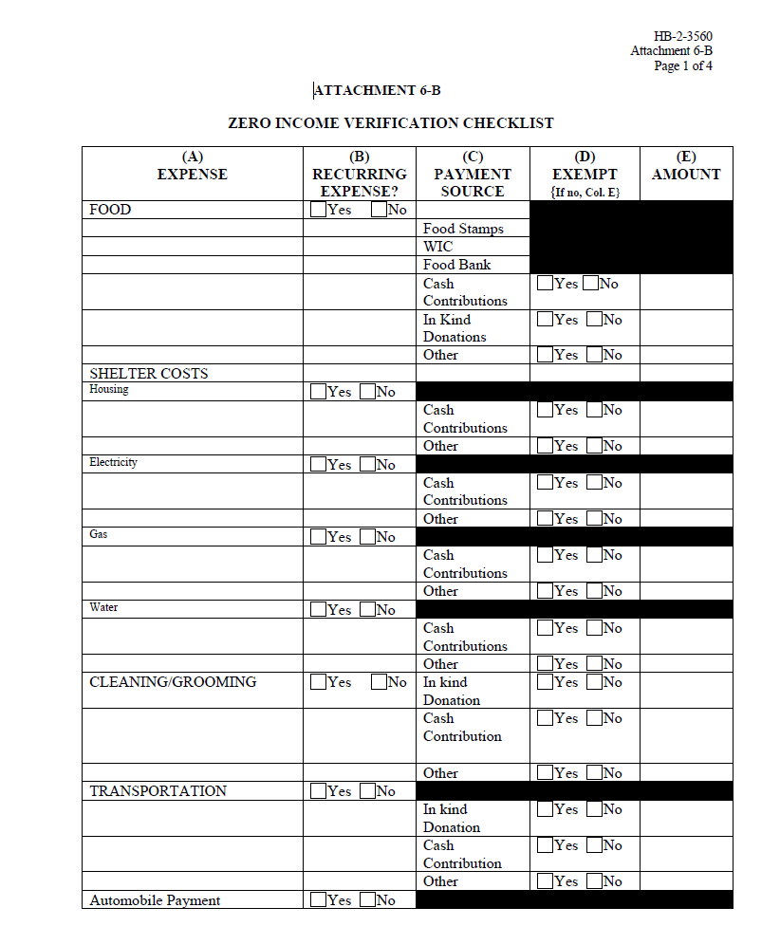
Tenant Certifications – Zero Income Tenants

Slide 11
Tenant Certifications - Students
The student is of legal age in accordance with the applicable state law or is otherwise legally able to enter into a binding contract under state law.
The person seeking occupancy has established a household separate and distinct from the person’s parent or legal guardians.
The person seeking occupancy is no longer claimed as a dependent by the person’s parents or legal guardians pursuant to Internal Revenue Service regulations, and evidence is provided to this effect.

Slide 12
Tenant Re-certifications

Slide 13
Tenant Recertification
Notifying the Tenant of the Recertification Requirement
At least 75 to 90 days prior to the date that the certification expires, the borrower must notify the tenant in writing that they must be recertified to remain eligible to continue residence at the property. This letter will also include what information the borrower needs from the household in order to complete the certification.
If the household still fails to respond to the letter, the borrower should issue a second letter 30 days prior to the date which the certification expires informing the tenant of the:
Information needed to recertify;
The time frame in which the new certification must be submitted to the Agency; and
The consequences for failure to comply with the recertification process.
HB-2-3560 page 6-37

Slide 14
Leases

Slide 15
Lease Issues
Initial leases must be for a 1-year period.
Additionally, all lease renewal or extensions must be for a 1-year period. 7 CFR 3560.156(b)
All leases must be signed by the tenant and management agent.
If you use lease addendums to extend the term of the lease they must reference back to the original lease date.

Slide 16
Waiting Lists

Slide 17
Waiting Lists
All applications, whether complete, eligible, or ineligible must be placed on the waiting list.
The date and time a complete application is received must be recorded on the waiting list.
The race, ethnicity and gender of each applicant must be recorded.
If the applicant doesn’t provide race, ethnicity, or gender the management agent must assign each attribute bated on visual observations or surname.

Slide 18
Waiting Lists
When an applicant has submitted an application form, the borrower must place the applicant on the waiting list. All applications, whether complete, eligible, or ineligible, will be placed on the list. The waiting list will document the disposition of all applications (rejected, withdrawn, or placed in unit).
7 CFR 3560.154 (f)(1)

Slide 19
Waiting Lists
Selections for the waiting lists shall be made in the following order, very low, low and then moderate income applicants.
Priority over all other applicants regardless of income
Persons who require special design features of a accessible unit
Applicant with a Letter of Priority Entitlement
Displaced from RD-financed housing with LOPE
Displaced in a Federally declared disaster area

Slide 20
Waiting Lists
Within 10 days of receipt of a complete application, the Borrower must notify the applicant in writing that he has been selected for immediate occupancy, placed on a waiting list, or rejected.
7 CFR 3560.154(f)(4)

Slide 21
Waiting Lists
Question
How Many Waiting lists should each property have?
A: one
B: two
C: it depends on the property make up

Slide 22
Waiting Lists
Transfer of existing tenants within a housing project. When a rental unit becomes available for occupancy and an eligible tenant in the housing project is either over housed or under housed as provided for in paragraph (e) of this section, the borrower must use the available unit for the over housed or under housed tenant, if suitable, prior to selecting an eligible applicant from the waiting list.
7 CFR 3560.155(c)

Slide 23
Supervisory Visits

Slide 24
Supervisory Visits
Agency staff review all aspects of the properties operations. This includes both the physical and management aspects of the property.
Ensure the property is managed in accordance with the goals & objectives of the MFH program.
Confirm that the property is being maintained to provide housing that is decent, safe, sanitary, and affordable

Slide 25
Supervisory Visits
During a Supervisory Visit agency staff will review the following aspects of the property’s operations:
Tenant Files
Operational Review
Maintenance Review
Physical Inspection
Tenant Interviews
Civil Rights Review

Slide 26
Supervisory Visits – Tenant File Review
Selected by MFIS by identified risk factors
Income less than <$3000
Medical Deductions
Initial Certification
Move Out
Evictions
Adequate Documentation
Proper Verification
Annual Income/Adjusted Annual Income in accordance with:
HUD 24 CFR 5.609 and 5.611
HUD Handbook 4350.3, Chapter 5 Determining Income and Calculating Rent

Slide 27
Supervisory Visits – Operational Review
Project records
Marketing materials
Applications
Waiting List
Ensure correct posters are posted.
Costs Controls
Reserve Account/Capital Planning
May request copies of:
Lease, Occupancy Rules, Tenant Selection Plan, Bank Statements, Advertising, Insurance Declaration page
Form sent out with SV letter

Slide 28
Supervisory Visits – Maintenance Review
Preventive Maintenance
Response to calls
Work Orders
Inspections
Energy Conservation
Tenant Damages
Accessibility Issues

Slide 29
Supervisory Visits – Physical Inspection Review
Examine the ground’s, exteriors, common areas, and interior units.
Adequate Maintenance
Performance Standards and Maintenance Procedures
7 CFR 3560.103(a)(3) and 7 CFR 3560.103(b)
Units will be inspected based on the following:
30 units or less, the Agency will visit 6 occupied units.
31-74 units the Agency will visit 10 occupied units.
75+ units, the Agency must inspect 15 occupied units.
All vacant units will be inspected.

Slide 30
Supervisory Visits – Tenant Interview
Grievance Process
Certification/Verification
Maintenance/Repairs
Process and Response
Reasonable Accommodation
General Questions

Slide 31
Supervisory Visits – Civil Rights Review
Waiting List
Management Plan
Review lease & application
Ineligible occupant of fully accessible unit
Inspection of project to determine if physical barriers.
Review Transition Plan
Interview tenants/Community Members

Slide 32
Supervisory Visits
The top four items that are found to be lacking during a Supervisory Visits:
Waiting lists are not being administered correctly.
Either a missing or outdated Transition Plan.
Over housed tenants, ie: 1 person in a two bedroom unit.
Failing to meet the maintenance standards listed in 7 CFR 3560.103.

Slide 33
Questions?

Slide 34
Additional Trainings
ARHC and USDA Rural Development Training
When: July 31, 2019 10-2pm
Where: USDA Service Center - Training room
1835 Black Lake Blvd Olympia, WA 98512
Topics: VAWA, Waiting Lists, Tenant Files, Budgets/Annual Reports

Slide 35
USDA NON-DISCRIMINATION STATEMENT In accordance with Federal civil rights law and U.S. Department of Agriculture(USDA) civil rights regulations and policies, the USDA, its Agencies, offices, and employees, and institutions participating in or administering USDA programs are prohibited from discriminating based on race, color, national origin, religion, sex, gender identity(including gender expression), sexual orientation, disability, age, marital status, family/parental status, income derived from a public assistance program, political beliefs, or reprisal or retaliation for prior civil rights activity, in any program or activity conducted or funded by USDA (not all bases apply to all programs).Remedies and complaint filing deadlines vary by program or incident. Persons with disabilities who require alternative means of communication for program information(e.g., Braille, large print, audiotape, American Sign Language, etc.) should contact the responsible Agency or USDA’s TARGET Center at (202) 720-2600 (voice and TTY) or contact USDA through the Federal Relay Service at (800) 877-8339. Additionally, program information maybe made available in languages other than English. To file a program discrimination complaint, complete the USDA Program Discrimination Complaint Form, AD-3027, found online at http://www.ascr.usda.gov/complaint_filing_cust.html and at any USDA office or write a letter addressed to USDA and provide in the letter all of the information requested in the form. To request a copy of the complaint form, call (866) 632-9992. Submit your completed form or letter to USDA by: U.S. Mail: U.S. Department of Agriculture Office of the Assistant Secretary for Civil Rights 1400 Independence Avenue, SW Washington, D.C. 20250-9410 Fax: (202) 690-7442 Email: program.intake@usda.gov.

Slide 36
Eric Siebens
Rural Development
Washington State
eric.siebens@usda.gov
509.415.3822
www.rd.usda.gov

